Slide 1

InvisibleShield: Human to Bot Differentiating AI
Major Project Presentation
(CUML 1025)
Presented by:-
Satyajit Parida (220301120006)
Arpita Priyadarshini (220301120060)
Under the supervision of
Dr. Pushkar Kishore

Slide 2
Contents:-
Introduction
Objectives
Dataset Architecture
Modules Implemented
Workflow
Results
Conclusion
References

Slide 3
Introduction:-
Increasing Bot Activity Automation has led to a surge in bot-based attacks across web platforms.
Need for Robust Verification Reliance solely on static verification is not sufficient for modern threats.
Behavioral Detection Approach Analyzing natural human behaviors like mouse movements and keystroke dynamics.
Two-Layered Verification Implements mouse dynamics and typing pattern analysis for accurate classification..

Slide 4
Objective:-
✅ To design and implement a bot detection system based on human behavioral patterns.
✅ To analyze mouse movement velocity variability for user authenticity.
✅ To evaluate keystroke dynamics using typing speed and timing fluctuations.
✅ To develop real-time verification using Python and Flask.
✅ To build a GUI-based distorted text CAPTCHA as an additional verification layer.
✅ To ensure the entire system works offline without third-party service dependencies.
✅ To provide modular, integration-ready components for deployment on web platforms.

Slide 5
Dataset Architecture:-
Feature Type | Columns Included | Description
Keystroke Data | Key, Timestamp, Time_Difference, Rolling_WPM, Label | Captures typing behavior. Includes time gaps between keys and words per minute analysis.
Mouse Data | X, Y, Timestamp, Time_Difference, Distance, Speed, Click_Type, Label | Tracks mouse movement trajectory, speed, and click types with time intervals.
Both datasets are preprocessed and scaled for uniform input to the verification system.
Each entry is labeled to distinguish between bot and human behavior.
Datasets are used independently in two parallel pipelines: keystroke analysis and mouse movement analysis.
Cleaned data ensures high model precision and efficient heuristic-based evaluation.
The architecture supports modular integration with real-time data collection APIs.

Slide 6
Modules Implemented:-
CAPTCHA Verification (Tkinter):-
Random text generation
Distorted image rendering
GUI input validation
Mouse Movement Analysis:-
Velocity computation
Variability threshold comparison
Typing Pattern Analysis:-
Speed calculation
Interval-based variability detection
Flask API Integration:-
Mouse: /api/verify-mouse-movement
Typing: /api/verify-typing

Slide 7
Workflow:-
Data Capture
Preprocessing
Mouse Analysis
Typing Analysis
Captcha Challenge
Result Response

Slide 8
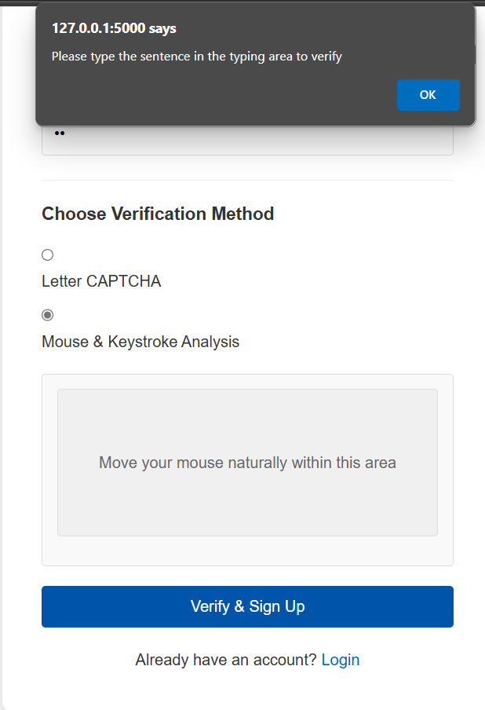
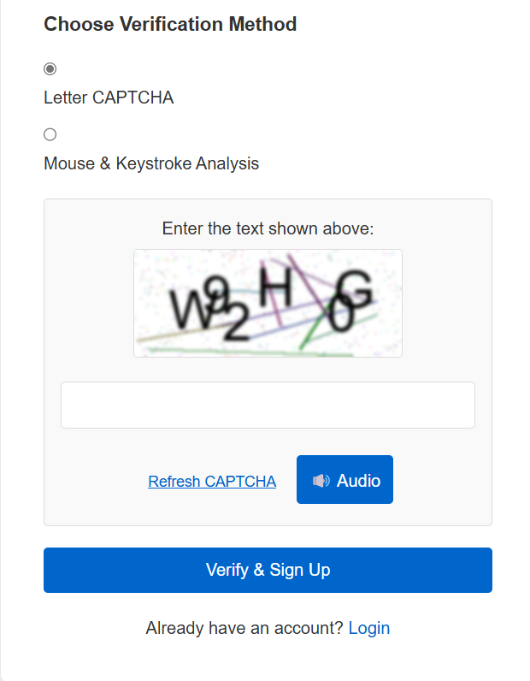
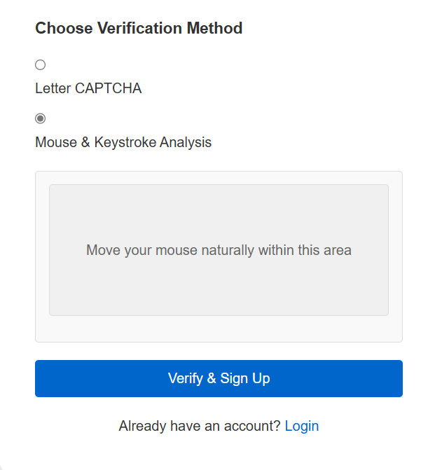
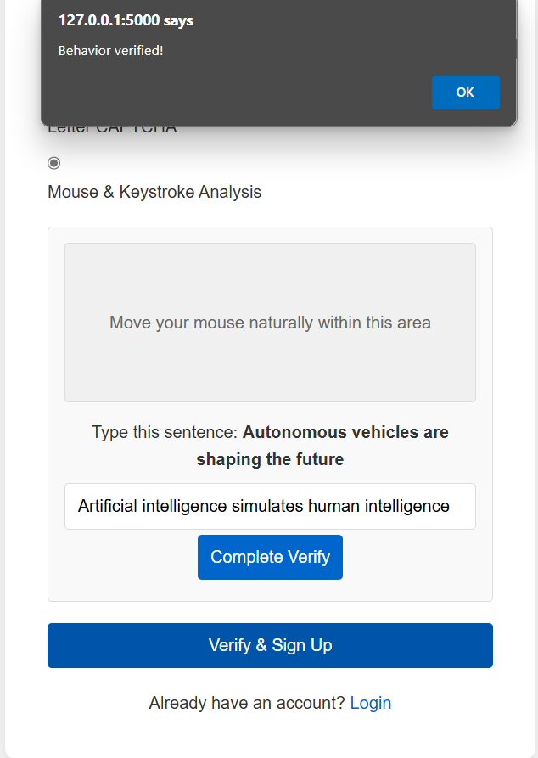
Results:-

Slide 9
Conclusion:-
The project demonstrates a modular approach to bot detection using behavioral biometrics, specifically keystroke dynamics and mouse movement patterns. It accurately distinguishes human users from bots using real-time user interaction data. The system integrates behavior-based verification and a GUI-based distorted text CAPTCHA, providing a multi-layered security mechanism. Developed using Python and Flask, it is offline, lightweight, and doesn't require external APIs or machine learning models, making it suitable for secure environments. The datasets are cleaned and scaled for consistent performance across user inputs.

Slide 10


